Slide 1
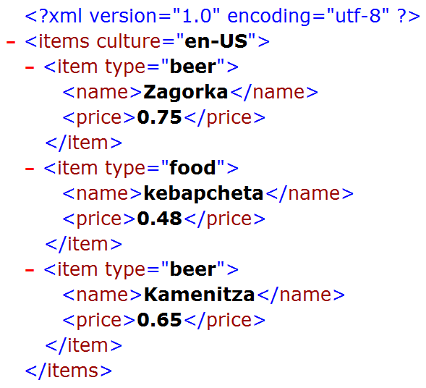






XML Basics
Basic XML Concepts, Schemas, XPath, XSL
Telerik Software Academy
Learning & Development Team
http://academy.telerik.com

Slide 2

Table of Contents
What is XML?
XML and HTML
When to use XML?
Namespaces
Schemas and validation
DTD and XSD Schemas
XML Parsers
XPath Language
XSL Transformations

Slide 3

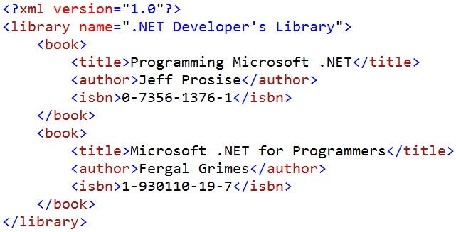
What is XML?

Slide 4
What is XML?
XML (eXtensible Markup Language)
Universal language (notation) for describing structured data using text with tags
The data is stored together with the meta-data about it
Used to describe other languages (formats) for data representation
XML looks like HTML
Text based language, uses tags and attributes

Slide 5

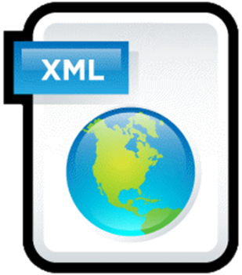
What is XML? (2)
Worldwide standard, supported by the W3C (www.w3c.org)
Independent of the hardware platform, OS and programming languages

Slide 6

XML – Example
<?xml version="1.0"?>
<library name=".NET Developer's Library">
<book>
<title>Professional C# 4.0 and .NET 4</title>
<author>Christian Nagel</author>
<isbn>978-0-470-50225-9</isbn>
</book>
<book>
<title>Silverlight in Action</title>
<author>Pete Brown</author>
<isbn>978-1-935182-37-5</isbn>
</book>
</library>

Slide 7
XML – Example (2)
XML header tag (prolog)
Attribute (key / value pair)
<?xml version="1.0"?>
<library name=".NET Developer's Library">
<book>
<title>Professional C# 4.0 and .NET 4</title>
<author>Christian Nagel</author>
<isbn>978-0-470-50225-9</isbn>
</book>
<book>
<title>Silverlight in Action</title>
<author>Pete Brown</author>
<isbn>978-1-935182-37-5</isbn>
</book>
</library>
Root (document) element
Opening tag
Element
Closing tag
Element value

Slide 8
XML and HTML
Similarities between XML and HTML
Both are text based notations
Both use tags and attributes
Differences between XML and HTML
HTML is a language, and XML is a syntax for describing other languages
HTML describes the formatting of information, XML describes structured information
XML requires the documents to be well-formatted

Slide 9
Well-Formatted XML Documents
Well-formatted XML:
All tags should be closed in the correct order of nesting
Attributes should always be closed
The document should contain only one root element
Tag and attribute names retain certain restrictions

Slide 10


Well-Formed XML Documents (2)
Example of incorrect XML document
Open / close tags do not match
Unclosed attribute values
Invalid characters
…
<xml>
<button bug! value="OK name="b1">
<animation source="demo1.avi"> 1 < 2 < 3
</click-button>
< / xml >

Slide 11
When to Use XML?
Advantages of XML:
XML is human readable (unlike binary formats)
Any kind of structured data can be stored
Data comes with self-describing meta-data
Custom XML-based languages can be developed for certain applications
Information can be exchanged between different systems with ease
Unicode is fully supported

Slide 12
When to Use XML? (2)
Disadvantages of XML:
XML data is bigger (takes more space) than in binary formats
More memory consumption, more network traffic, more hard-disk space
Decreased performance
Need of parsing / constructing the XML tags
XML is not suitable for all kinds of data
E.g. graphics, images and video clips

Slide 13

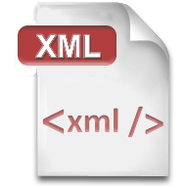
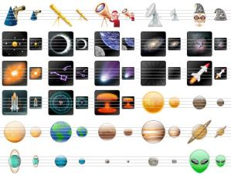
XML Namespaces

Slide 14
Namespaces
XML namespaces are defined like this:
<?xml version="1.0" encoding="utf-8"?>
<sample:towns
xmlns:sample="http://www.academy.com/towns/1.0">
<sample:town>
<sample:name>Sofia</sample:name>
<sample:population>1200000</sample:population>
</sample:town>
<sample:town>
<sample:name>Plovdiv</sample:name>
<sample:population>700 000</sample:population>
</sample:town>
</sample:towns>

Slide 15
Namespaces (2)
Namespaces in XML documents allow using different tags with the same name:
<?xml version="1.0" encoding="UTF-8"?>
<country:towns
xmlns:country="urn:academy-com:country"
xmlns:town="http://www.academy.com/towns/1.0">
<town:town>
<town:name>Plovdiv</town:name>
<town:population>700 000</town:population>
<country:name>Bulgaria</country:name>
</town:town>
</country:towns>

Slide 16
Namespaces – Example
Namespace with prefix "country" and URI "urn:academy-com:country"
<?xml version="1.0" encoding="UTF-8"?>
<country:towns xmlns:country="urn:academy-com:country"
xmlns:town="http://www.academy.com/towns/1.0">
<town:town>
<town:name>Sofia</town:name>
<town:population>1 200 000</town:population>
<country:name>Bulgaria</country:name>
</town:town>
<town:town>
<town:name>Plovdiv</town:name>
<town:population>700 000</town:population>
<country:name>Bulgaria</country:name>
</town:town>
</country:towns>
Tag named "name" from namespace "country" → the full tag name is "urn:academy-com:country:name"

Slide 17
Namespaces – Example (2)
Default namespaces can save some code:
<?xml version="1.0" encoding="windows-1251"?>
<order xmlns="http://www.supermarket.com/orders/1.1">
<item>
<name>Beer "Zagorka"</name>
<ammount>8</ammount>
<measure>bottle</measure>
<price>5.60</price>
</item>
<item>
<name>Meat balls</name>
<ammount>12</ammount>
<measure>amount</measure>
<price>5.40</price>
</item>
</order>
Default namespace – applied for the entire XML document

Slide 18
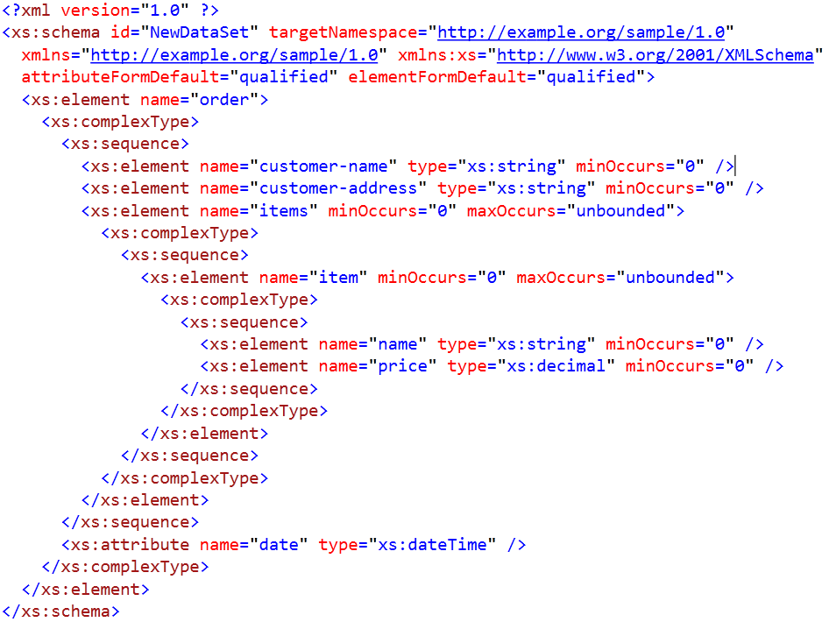

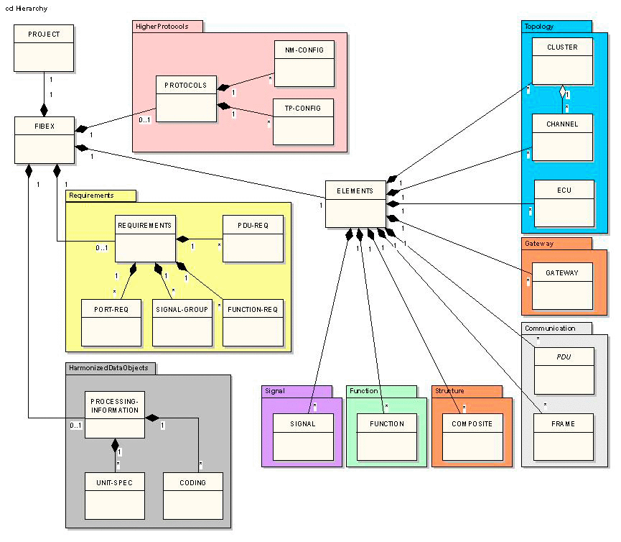

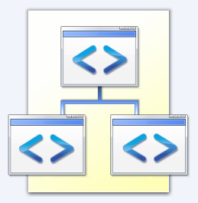
XML Schemas and Validation

Slide 19
XML Schemas and Validation
The XML documents structure is defined by schemas
XML schemas describes:
Possible attributes and tags and their values
Tags order
Default values and number of appearances
There are few XML Schema standards:
DTD – Document Type Definition
XSD – XML Schema Definition Language

Slide 20
The DTD Language
DTD (Document Type Definition) is:
Formal language for describing XML document structures
Contains a set of rules for the tags and their attributes in a document
Text-based language, but not XML based
Substituted by XSD (relatively rarely used)
<!ELEMENT library (book+)>
<!ATTLIST library name CDATA #REQUIRED>
<!ELEMENT book (title, author, isbn)>
<!ELEMENT title (#PCDATA)>
<!ELEMENT author (#PCDATA)>

Slide 21
XSD Schemas
XSD (XML Schema Definition Language)
Powerful XML-based language for describing the structure of XML documents
Contains a set of rules for the tags and their attributes in a document
Specifies few standard data types
Numbers, dates, strings, etc.
XSD Schemas have greater descriptive power than DTD

Slide 22
XSD Schemas – Example
<?xml version="1.0" encoding="UTF-8"?>
<xs:schema xmlns:xs="http://www.w3.org/2001/XMLSchema"
targetNamespace="https://telerikacademy.com">
<xs:element name="library">
<xs:complexType>
<xs:sequence>
<xs:element ref="book"
maxOccurs="unbounded"/>
</xs:sequence>
<xs:attribute name="name"
type="xs:string" use="optional"/>
</xs:complexType>
</xs:element>
<xs:element name="book">
<xs:complexType>
<xs:sequence>
<xs:element ref="title"/>
<xs:element ref="author"/>
<xs:element ref="isbn"/>
</xs:sequence>

Slide 23

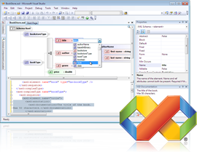
XSD Schemas – Example (2)
</xs:complexType>
</xs:element>
<xs:element name="title" type="xs:string"/>
<xs:element name="author" type="xs:string"/>
<xs:element name="isbn" type="xs:string"/>
</xs:schema>

Slide 24
Reference DTD and XSD
<?xml version="1.0"?> <!DOCTYPE library SYSTEM "[file path]"> <library> <book>
<title>Professional C# 4.0 and .NET 4</title>
<author>Christian Nagel</author>
<isbn>978-0-470-50225-9</isbn>
</book> </library>
<?xml version="1.0"?> <library xmlns="[namespace]" xmlns:xsi="http://www.w3.org/2001/XMLSchema-instance" xsi:schemaLocation="[namespace path]"> <book>
<title>Professional C# 4.0 and .NET 4</title>
<author>Christian Nagel</author>
<isbn>978-0-470-50225-9</isbn>
</book> </library>

Slide 25

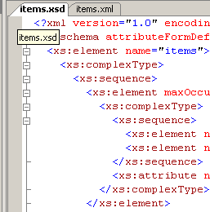
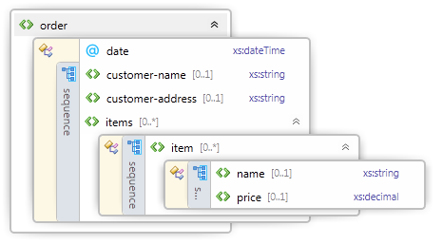
Visual Studio Schema Editor
Visual Studio can generate XSD Schemas from the structure of a given XML document
VS has powerful XSD Schema Editor
Visually edit schemas

Slide 26
Working with the XSD Editor in Visual Studio
Live Demo

Slide 27




XML Parsers

Slide 28
XML Parsers
XML parsers are programming libraries that make the work with XML easier
They serve for:
Extracting data from XML documents
Modifying existing XML documents
Building new XML documents
Validating XML documents by given schema
Transforming XML documents

Slide 29
XML Working Models
They have several working models:
DOM (Document Object Model)
Represents XML documents as a tree in the memory
Allows processing and modifying the document
SAX (Simple API for XML Processing)
Reads XML documents consequently tag by tag
Event-driven API
Allows analyzing the read portions at each step
StAX (Streaming API for XML)
Like SAX but works in "pull" mode

Slide 30
The DOM Parser
Given the following XML document:
<?xml version="1.0"?>
<library name=".NET Developer's Library">
<book>
<title>Professional C# 4.0 and .NET 4</title>
<author>Christian Nagel</author>
<isbn>978-0-470-50225-9</isbn>
</book>
<book>
<title>Silverlight in Action</title>
<author>Pete Brown</author>
<isbn>978-1-935182-37-5</isbn>
</book>
</library>

Slide 31
The DOM Parser (2)
This document is represented in the in the memory as a DOM tree in the following way:
Header part (prolog)
Root node

Slide 32
The SAX Parsers
The SAX parsers:
Iterate the document consequently tag by tag
Invoke callback functions (events) when particular node is reached
Stream-like access – going backwards or jumping ahead is not allowed
Require many times less resources (memory and loading time)
Work well over streams

Slide 33
The StAX Parser
StAX is like SAX but
"Pull"-based parser
Not event driven (not callback based)
Developer manually say "go to next element" and analyze it
SAX vs. StAX
SAX reads the documents and invokes callbacks like "node found", "attribute found", etc.
In StAX parsers the read is invoked by the developer synchronously

Slide 34
When to Use DOM and When to Use SAX / StAX?
Use DOM processing model when:
Process not big documents (e.g. less than 10 MB)
There is a need of flexibility
To modify XML documents
Use SAX / StAX processing model when:
Process big documents
The performance is important
There is no need to change the document

Slide 35


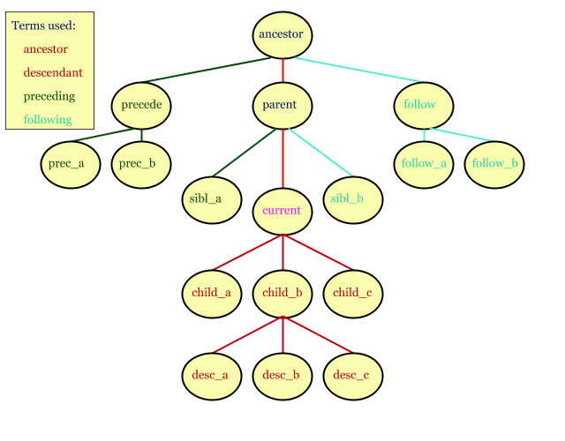
XPath

Slide 36
XPath
XPath (XML Path Language) is a language for addressing parts of XML documents
XPath expressions contains description of paths to nodes and filter criteria
Example for XPath expressions:
/library/book[isbn='1-930110-19-7']
/catalog/cd[@price<10.80]
/book/chapter[3]/paragraph[last()]

Slide 37
XPath Expressions
/ – addresses the root element derived
/someNode – addresses all nodes with name "someNode", straight inheritors to the root
/books/book – addresses all nodes "book", straight inheritors to the node "books"
/books/book[price<10]/author – addresses all authors (/books/book/author), whose books have price < 10
/items/item[@type="food"] – addresses all nodes with name item (/items/item/), which have attribute "type" with value "food"

Slide 38
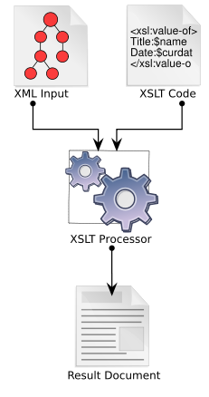
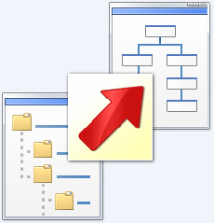
XSL Transformations
XSL

Slide 39
XSL Transformations
XSL transformations (XSLT) allows to
Transform of one XML document to other XML document with different structure
Convert between different XML formats
XSLT depends on XPath
XPath is used to match parts from the input document and replace them with another XML
In particular XSLT can be used for transforming XML documents to XHTML

Slide 40
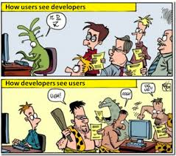
XSL Stylesheet – Example
<?xml version="1.0" encoding="windows-1251"?>
<xsl:stylesheet version="1.0"
xmlns:xsl="http://www.w3.org/1999/XSL/Transform">
<xsl:template match="/">
<html>
<body>
<h1>My library</h1>
<table bgcolor="#E0E0E0" cellspacing="1">
<tr bgcolor="#EEEEEE">
<td><b>Title</b></td>
<td><b>Author</b></td>
</tr>
<xsl:for-each select="/library/book">
<tr bgcolor="white">
<td><xsl:value-of select="title"/></td>
<td><xsl:value-of select="author"/></td>
</tr>
</xsl:for-each>
</table>
</body>
</html>
</xsl:template>
</xsl:stylesheet>

Slide 41
The XSL Language
<xsl:template match="XPath expr."> … </xsl:template> – replaces the pointed with XPath expression part of the document with the construction body
<xsl:for-each select="XPath expr."> … </xsl:for-each> – replaces each node, pointed by the XPath expression with construction body
<xsl:value-of select="XPath expr."/> – extracts the value of the given XPath expression (the first occurrence)
XSL patterns are valid XML documents!

Slide 42
XML Basics
http://academy.telerik.com

Slide 43
Exercises
What does the XML language represents? What does it used for?
Create XML document students.xml, which contains structured description of students. For each student you should enter information for his name, sex, birth date, phone, email, course, specialty, faculty number and a list of taken exams (exam name, tutor, score).
What does the namespaces represents in the XML documents? What are they used for?

Slide 44
Exercises (2)
Explore http://en.wikipedia.org/wiki/ Uniform_Resource_Identifier to learn more about URI, URN and URL definitions.
Add default namespace for the students "urn:students".
Create XSD Schema for the students.xml document. Add new elements in the schema: information for enrollment (date and exam score) and teacher's endorsements.
Write a XSL stylesheet to visualize the students as HTML. Test it in your favourite browser.

Slide 45



Free Trainings @ Telerik Academy
"Web Design with HTML 5, CSS 3 and JavaScript" course @ Telerik Academy
html5course.telerik.com
Telerik Software Academy
academy.telerik.com
Telerik Academy @ Facebook
facebook.com/TelerikAcademy
Telerik Software Academy Forums
forums.academy.telerik.com

